Slide 1

Spinner User Manual
JULY, 2024
Implemented by ELEVATE Ltd.
Funded by the Bureau of International Labor Affairs, USDOL IL358082075K

Slide 2
Table of contents
Introduction to the platform
Creating your account
Onboarding
Spinner Functionality
Product activities
Trace Product
Overview
Corrective Action Plan
My Profile- Edit Profile, Manage Business Partners, User Management
Forgot Password

Slide 3
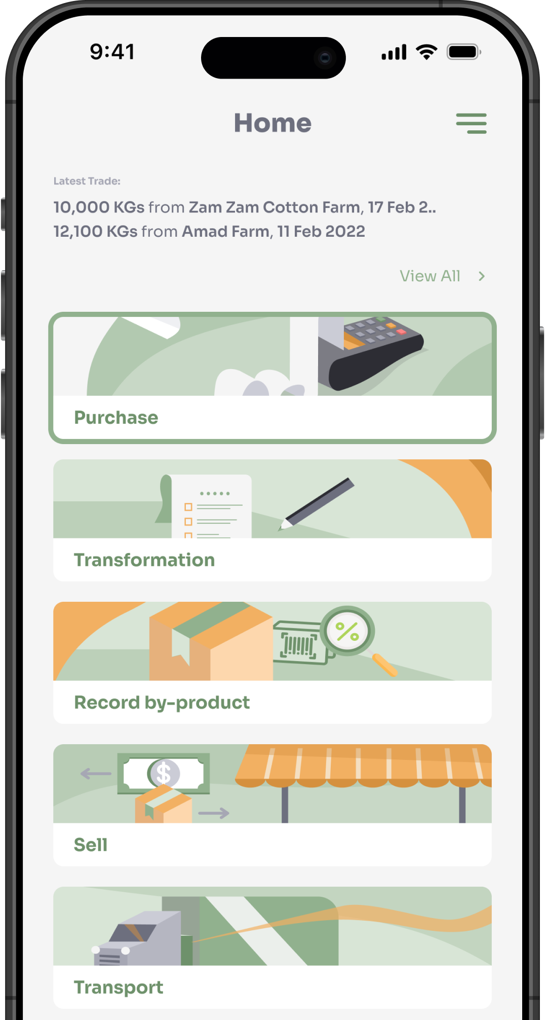

Introduction to the platform
Application can be accessed from the below URL
[URL Link]
Mobile application can be downloaded from Google Play Store and the App Store
AppStore Download:
[AppStore Link]
Play Store Download:
[Play Store Link]

Slide 4
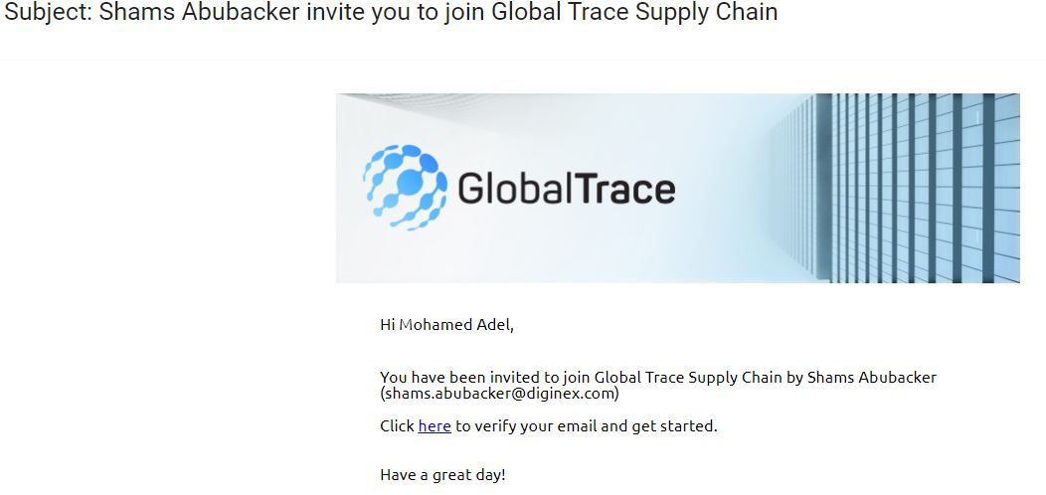
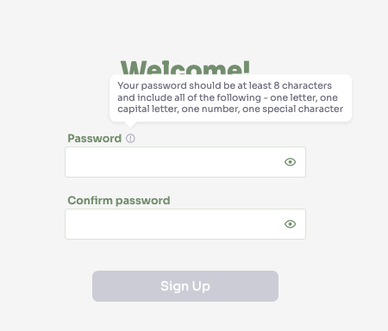
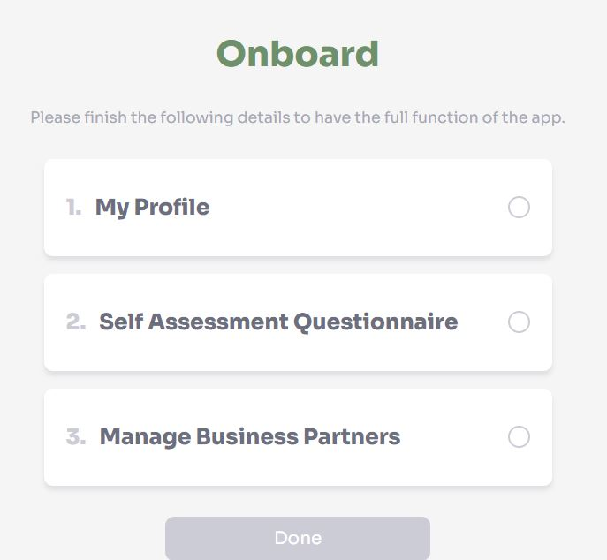
Creating your Account
On receipt of the invitation from GT, please click the link
Setup password
Follow the guidelines on how to create a strong password
On successful sign-up, you will begin process of onboarding
Complete Profile
Self Assessment Questionnaire
Manage Business Partners
Each process must be complete to access GT functionality

Slide 5
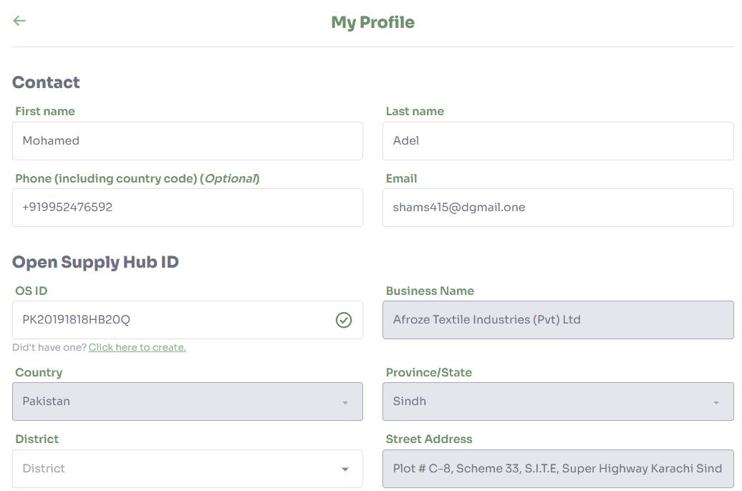
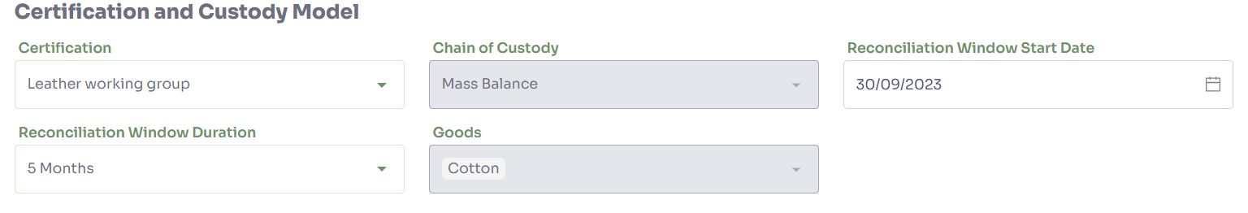
Onboarding: My Profile
First/Last Name - auto-populated from the GT’s invitation request, but can be updated
OSH ID – unique identifier assigned by the Open Supply Hub
Add existing OSH ID, or register for a new ID
Certification – Select your cotton certification
Goods – Select goods that your facility produces
Chain of Custody –Mass Balance
Specify reconciliation window start date plus duration

Slide 6
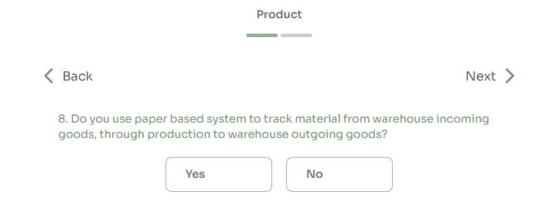
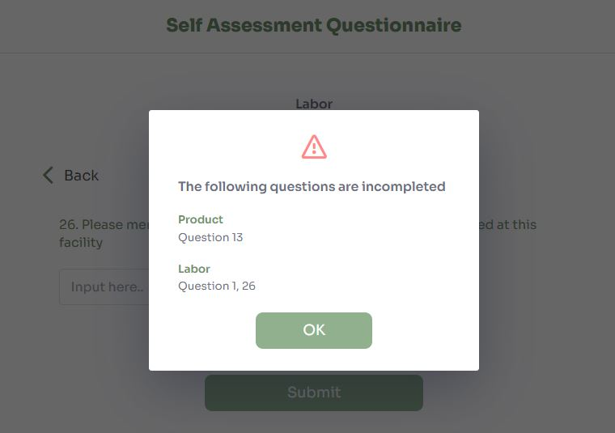
Onboarding: Self Assessment Questionnaire
Complete Self Assessment Questionnaire (SAQ)
Product Information
Labor risk Information
Save draft and continue later
On submission, automatic validation that each step is complete

Slide 7
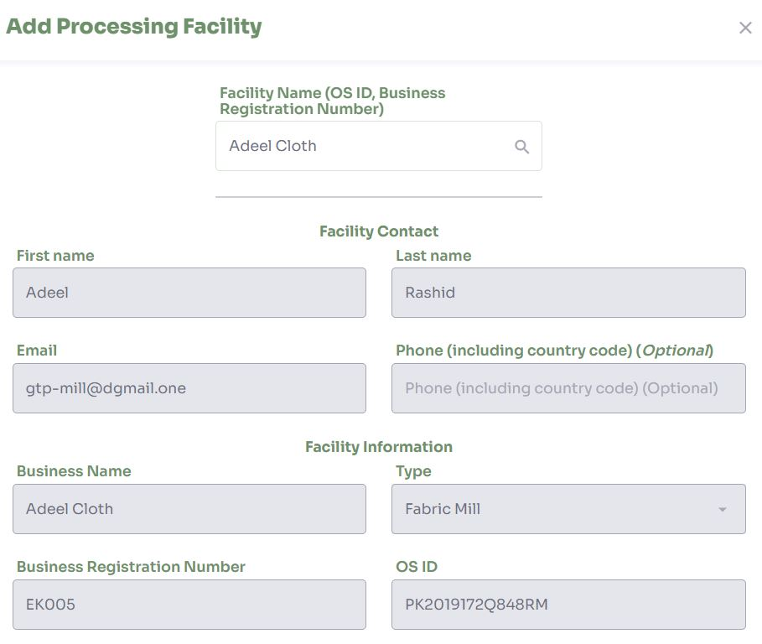
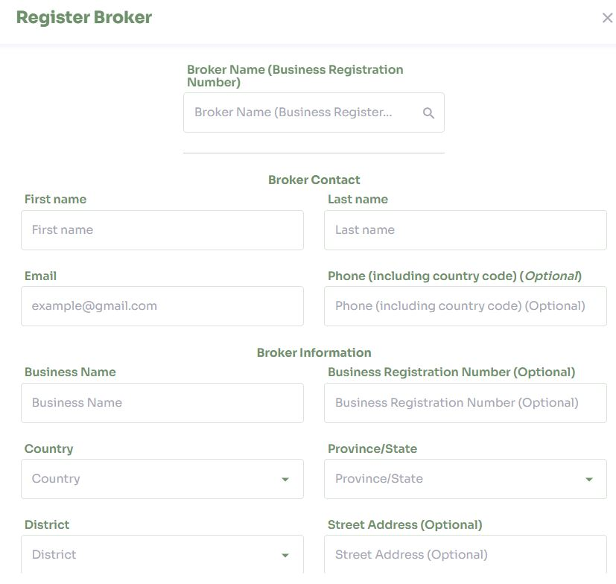
Onboarding: Add Business Partners
Business partner can be added in 2 ways – creating new or choosing existing from database
Search for business partners already registered on system
Add new business partner (fabric mill) to invite to the platform
Add new broker, by providing basic information

Slide 8
Spinner Functionality
Product Activities
Trace Product
Overview
Manage Partners
CAP
My Profile

Slide 9
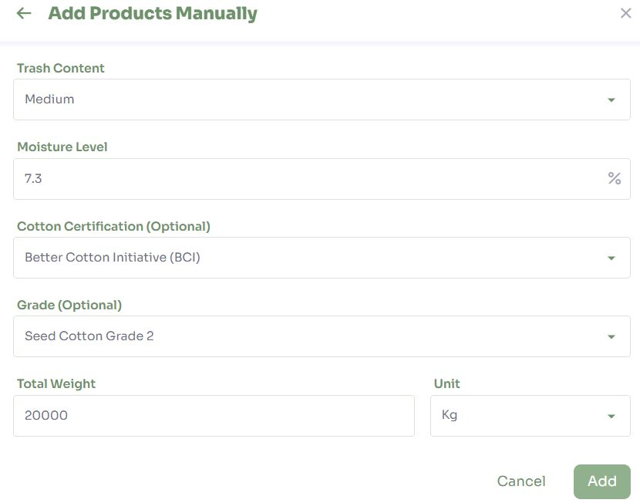
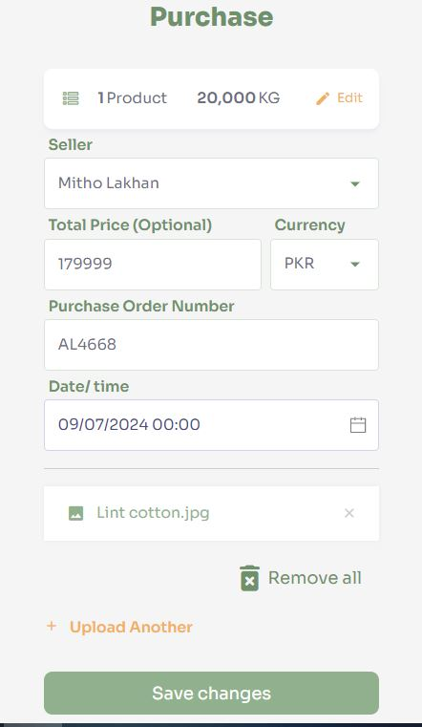
Product Activities - Purchase
Record purchase of lint cotton from business partner using product ID
Purchase Order number (or receipt) and attachment
Date / time of purchase
Optional: Price
Attachment can be uploaded from phone or photo taken

Slide 10
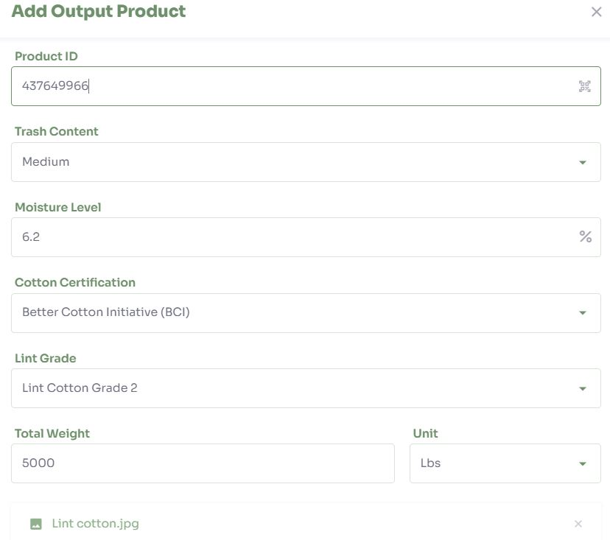
Product Activities - Transformation
Assign product ID to output product(yarn)
Add Input products
Weight, Product description
Optional: DNA Identifier
Attachment can be photo taken

Slide 11
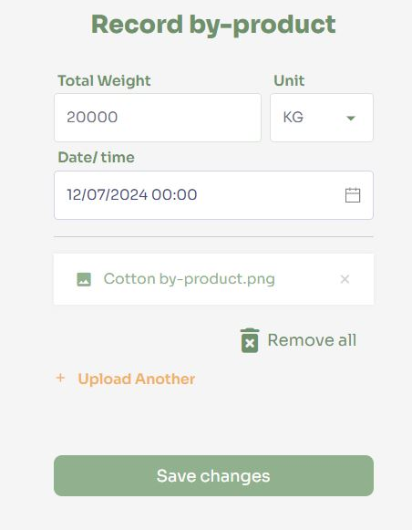
Product Activities – By-product
Record weight of by-product generated during transformation
Attachment can be photo taken

Slide 12
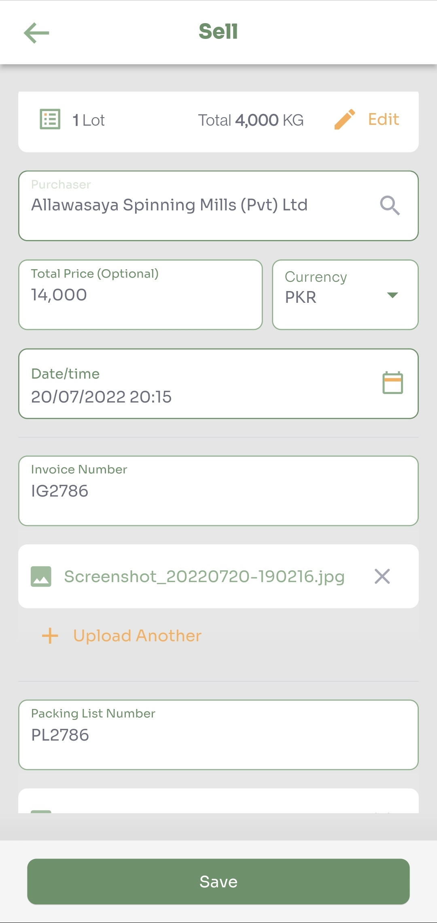
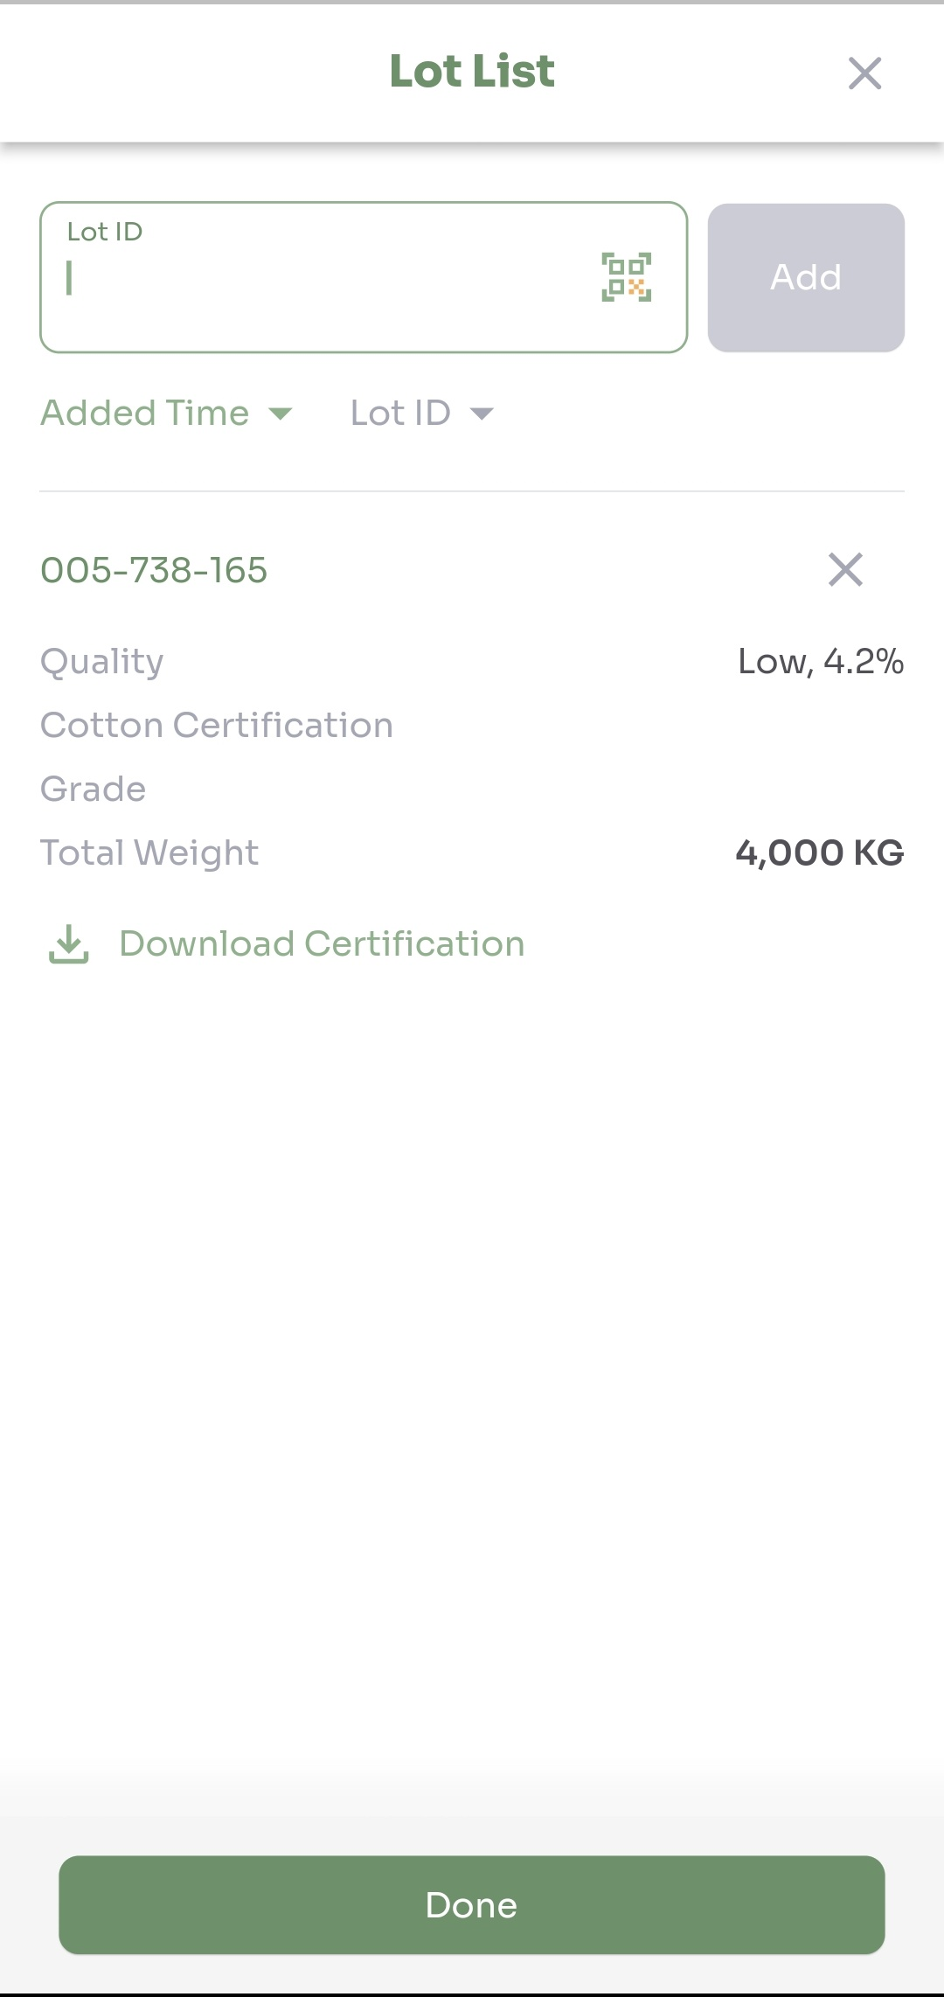
Product Activities - Sale
Record sale of output product(yarn) to business partner(Fabric mill)
Date / time of sale
Invoice number and attachment
Packing List number and attachment
Optional: Price
Attachment can be a photo taken

Slide 13
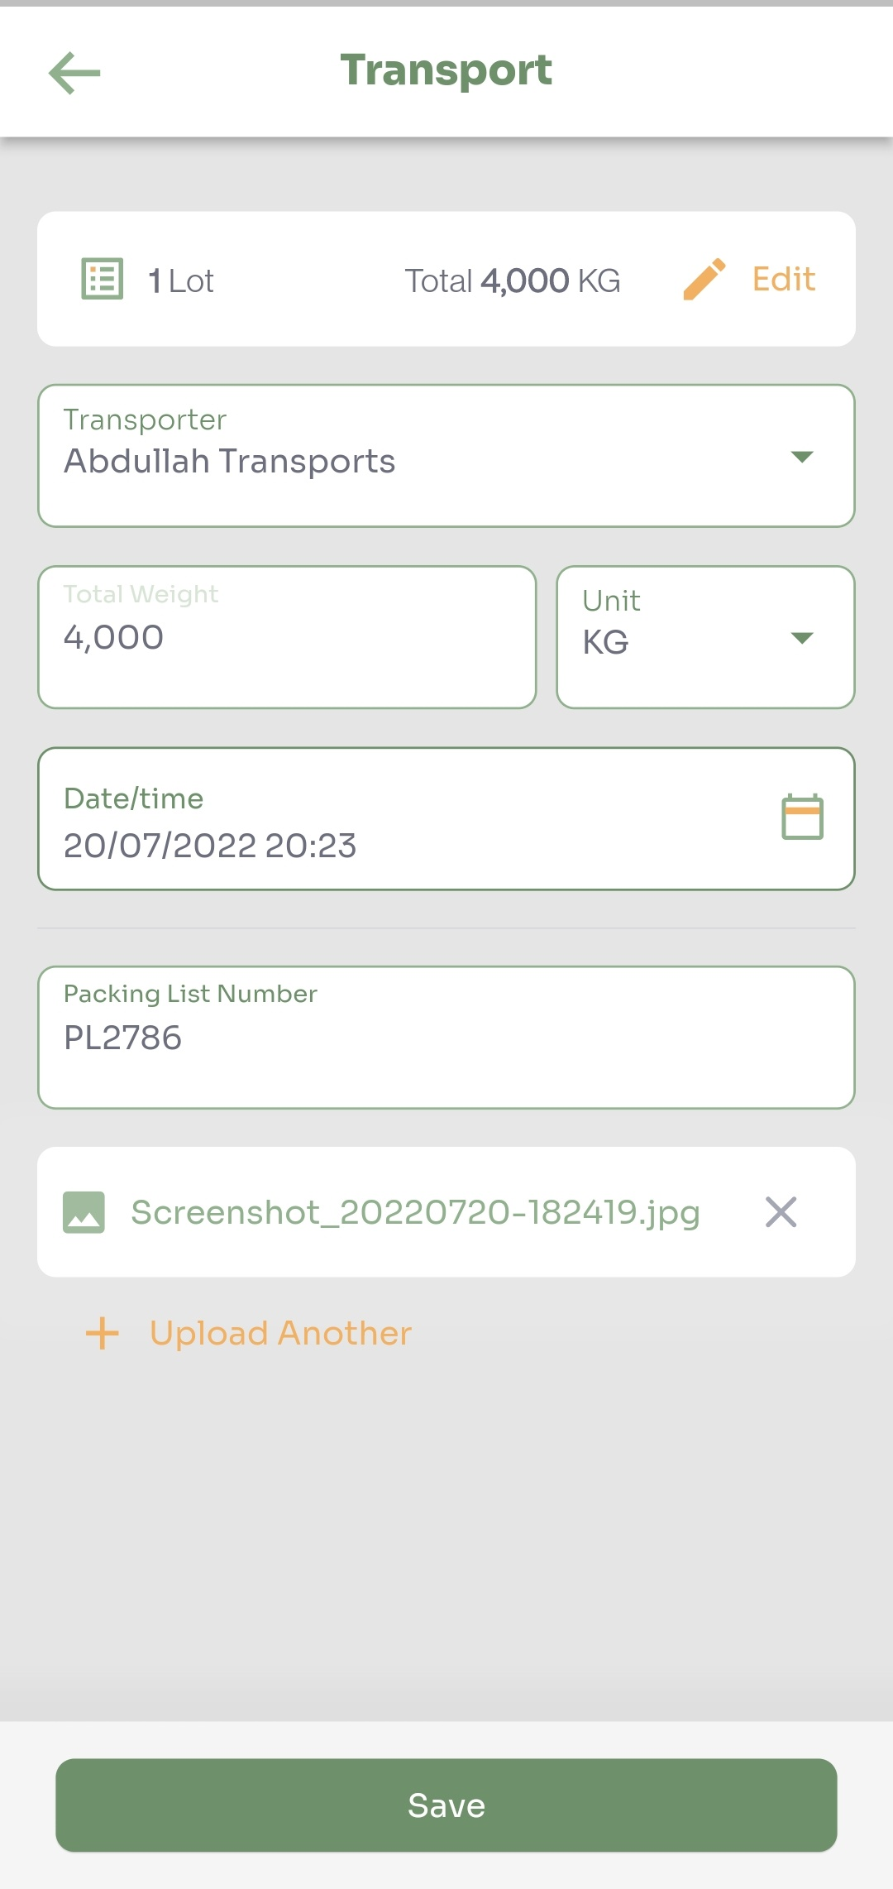
Product Activities - Transport
Record transportation of sold products to business partner
Transporter: Firm transporting the output product
Total weight
Date / time of shipment
Packing List number and attachment
Attachment can be a photo taken

Slide 14
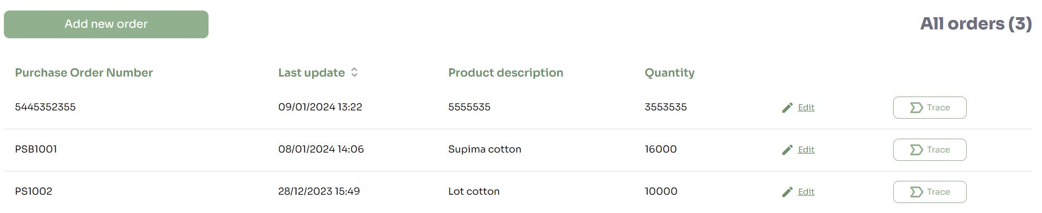
Create order
New order can be created by submitting
Purchase order number
Product description
Product quantity
Purchase date and Purchase Order/Invoice/Packing List number
An order is required to begin product trace

Slide 15
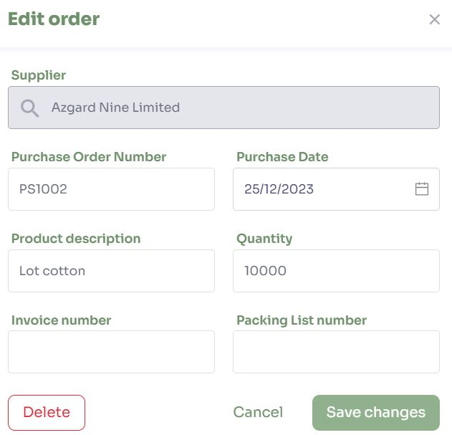
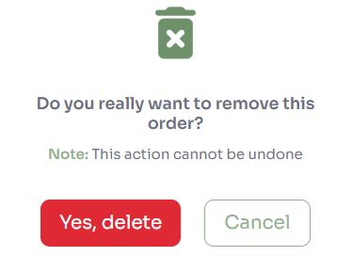
Edit/Delete order
Edit details of an existing order
Delete an order

Slide 16
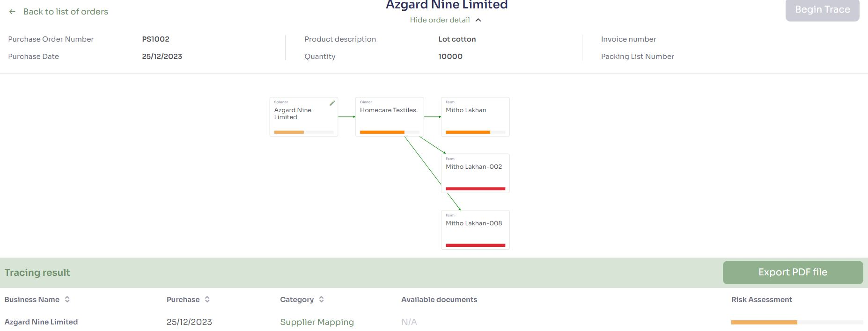
Trace an order
Click begin trace
System will find all transactions through the chain based on purchase date and purchase order number/Invoice number and Packing list number
Trace result table displays all transactions and available documents

Slide 17
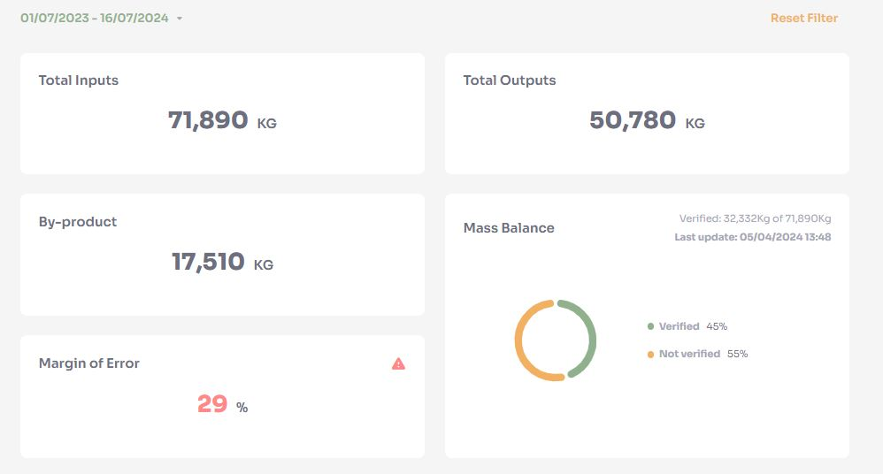
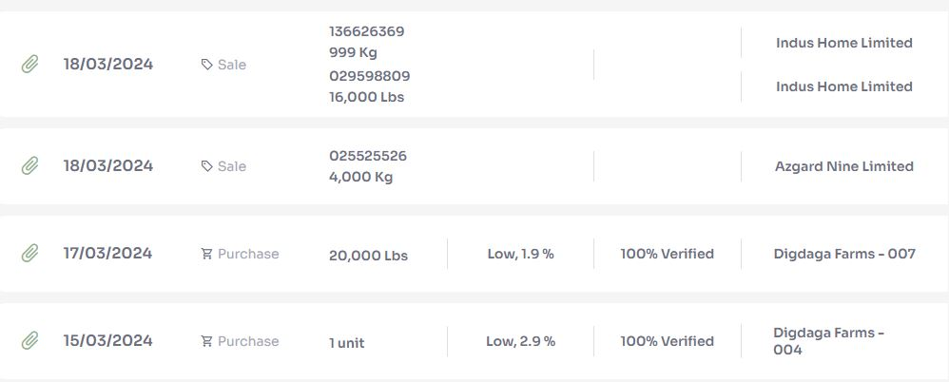
Overview
History of all operations performed by spinner
Display total quantity of input products purchased from business partners and output products sold to business partners; total quantity of by-products recorded during transformation
Click on individual record to view or download attachments

Slide 18
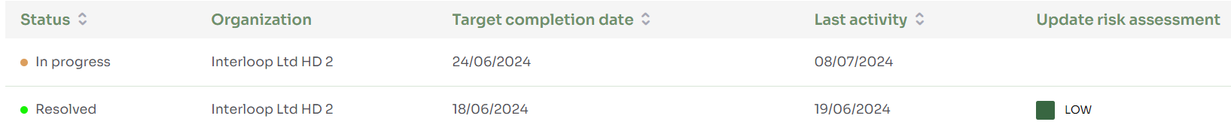
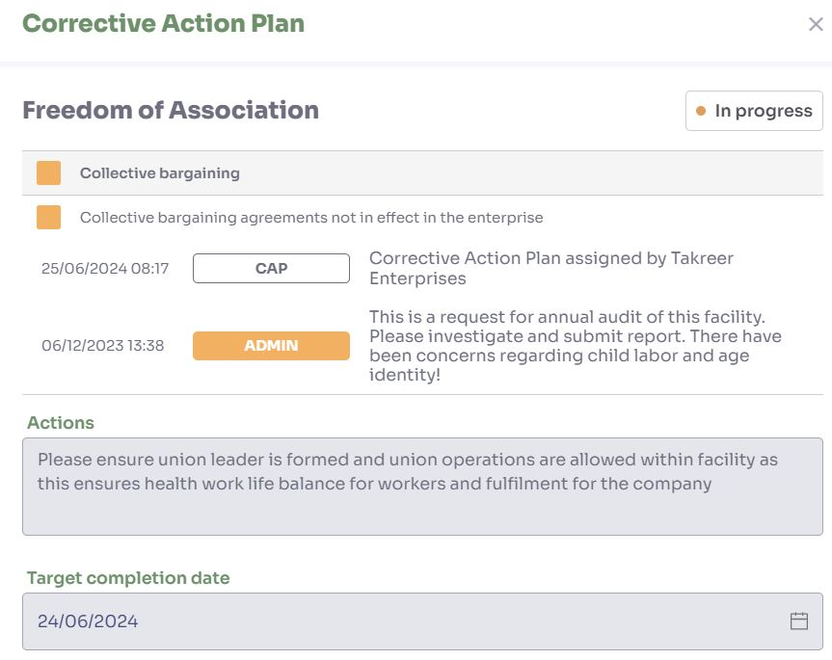
Corrective Action Plan
View all CAP records with their status and target completion date
Click on CAP record to view detailed information with actions and target completion date
After the CAP resolution, new risk level is assigned

Slide 19
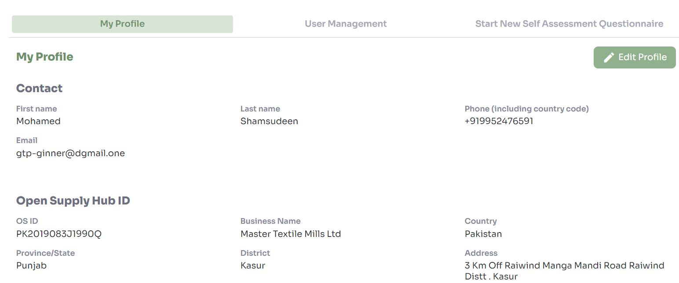
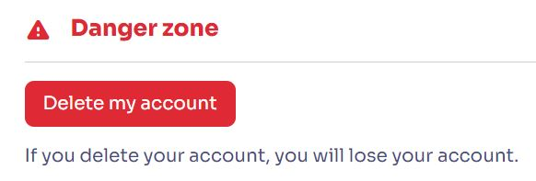
My Profile: Edit Profile, Delete own account
Enables spinner to edit details set during onboarding
Can delete account for compliance reasons

Slide 20
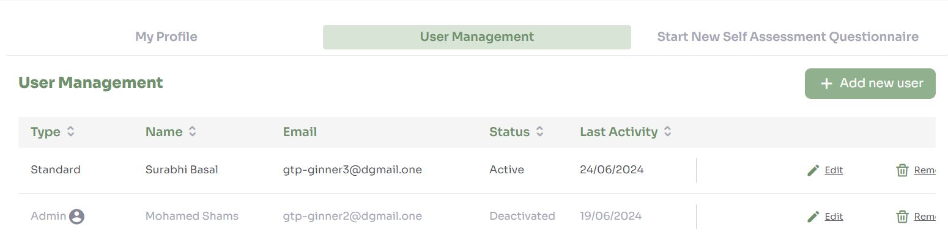
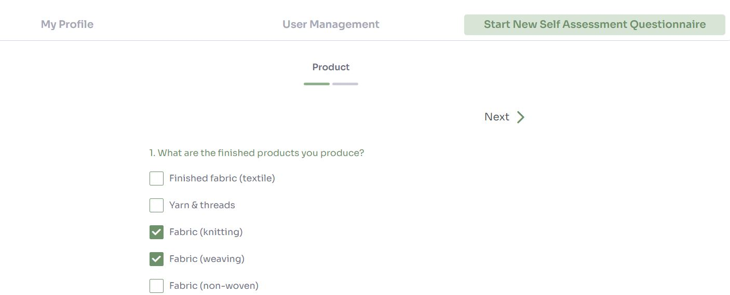
My Profile – User Management, retake assessments
Organization admin can invite multiple users as Standard/Admin
Can deactivate and delete users

Slide 21
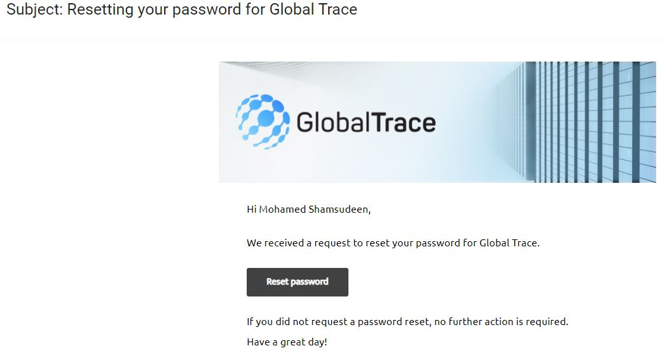
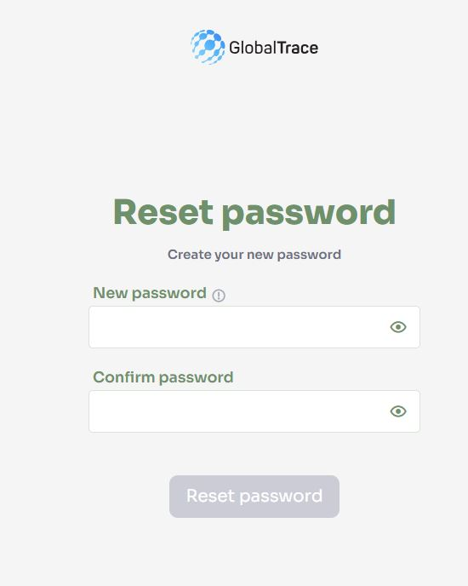
Forgot Password
If you forget your password, use ‘Forgot Password’ link on login page
Email sent to registered address
Click on link in email to reset your password

Slide 22

Funding is provided by the United States (U.S.) Department of Labor (DOL) under cooperative agreement number IL-35808-20-75-K. One hundred percent of the total costs of the project or program is financed with USG federal funds, for a total of $4 million dollars. This material does not necessarily reflect the views or policies of the United States Department of Labor, nor does mention of trade names, commercial products, or organizations imply endorsement by the United States Government.

Slide 23
Spinner User Manual
THANK YOU
Implemented by ELEVATE Ltd.
Funded by the Bureau of International Labor Affairs, USDOL IL358082075K

